Slide 1
York University WHA Simulation 2023 How to Write a Position Paper & How to Research Country and Topic Assignments

Slide 2
General Resources
To begin your research, you must first familiarize yourself with the structure, content, and purpose of the World Health Assembly Simulation. ​Refer to training module 2 for more information.​
Feel free to explore these general resources for more information: ​
https://www.macmun.org/resources​
https://www.worldhealthassemblysimulation.com/ ​
https://www.worldhealthassemblysimulation.com/_files/ugd/96c4f3_f7538797b12d4f948acd557941efcd50.pdf ​
Also, make sure to review the theme guide of your respective committee (A, B, or C).

Slide 3
What is a Position Paper?
A position paper is a publication that expresses an arguable viewpoint on a topic, usually that of the author or another entity. Position papers are written and published in academics, politics, law, and other fields.​
​
Position papers in academia allow for debate on developing topics without the experimentation and creative research that is typically seen in academic articles. Typically, such a publication will use evidence from an extended objective discussion of the topic to substantiate the viewpoints or positions advanced.​

Slide 4
What is the purpose of a Position Paper?
To help you prepare and organize your points ​
To deepen your knowledge of the topics in the agenda ahead of the conference ​
To aid you in making valid evidence-based country-specific arguments. ​
To use it as a guide throughout the conference during your speeches, moderated caucuses and resolution writing ​
To present your position in a clear and concise manner

Slide 5
Deadlines and other information
​
To be considered for an award you must submit​
1 page per topic​
Times New Roman, 12 pt. Font, Double spaced ​
DEADLINE :- April 28, 2023 at 11:59 pm​
Please email the paper to gh_whasim@yorku.ca.​
Include your Committee name in the Subject. ​
Chair
Vice-Chair
Secretariat

Slide 6
Paper Overview
Part 1: Introducing the Topic​
Provide a general overview of the topic and offer an understanding of the root cause of the conflict
Discuss the topic's historical significance, and any debates or controversies surrounding it.​
Part 2: Introducing Your Country/Character​
Offer background information on your assigned position and explain the connection between your country/character and the issue at hand.​
Describe your country/character's interest in the topic and how they have been impacted by it specifically.

Slide 7
Paper Overview
Part 3: Your Country's Policies and Proposed Solutions​
Explain your country's policies and the factors that led to their establishment, including historical events, internal issues, and other considerations.​
Discuss why your country has acted in a particular way in the past.​
Identify any relevant resolutions or conventions that your country has already signed onto.​
Describe how the positions of other countries impact your country's stances.​
Based on these factors, propose a feasible solution to the current or future problems.​
Ensure that your proposed solution aligns with your country's foreign policy.
Include any implementation considerations for your proposed solution.

Slide 8
Paper Overview
Part 4: Conclusion​
Summarize your country’s position and goals for the conference​
Recap your country's position on the topic being discussed at the conference.​
Outline the goals you hope to achieve during the conference.​
Explain what outcomes you would like to see, whether they involve reaching a consensus with other countries, achieving specific policy goals, or something else entirely.

Slide 9
Position Paper Checklist
​
One page per topic ​
Times New Roman, 12 pt. font​
Clear and formal language ​
Always use the third person when representing your country​
Be timely as you want to convince others to take a decision in your favour. ​
Any preferred citation style (APA citation recommended )​
The reference page is not included in the page count​
Do not include diagrams, tables, decorations, symbols or any design​
Include Header ​
Topic:- ​
Country:- ​
Committee:-

Slide 10
Position Paper Checklist
Always cite as this will also help you go back to your resources on the day of conference. ​
Zotero and Mendeley are great referencing software that help keep track of resources. ​
Strong sources will enable you to make valid points ​
Remember that sources that include statistics, verifiable actions, primary statements from prominent persons, and currently implemented policies articulate more than simple words.​
ALWAYS INCLUDE EVIDENCE

Slide 11
How to Research Country and Topic Assignments
To begin familiarizing yourself with your country's stance on an issue, you should explore their official state websites, national and international commitments, and current activities/efforts on the topic​
Explore recent and peer-reviewed academic articles on the topic at hand through the official York U library website and use keywords + Boolean operators to narrow your search​
Example: "Canada" AND "Universal Healthcare"

Slide 12
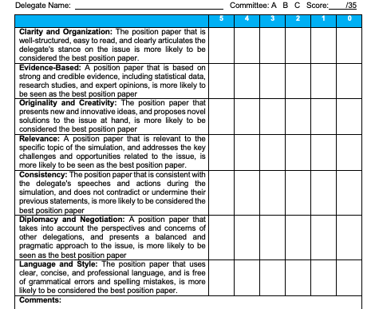
Best Position Paper Award Rubric

Slide 13
Important Contacts​
Email: gh_wha@yorku.ca​
Instagram: https://www.instagram.com/ghwhasim/​
Twitter: https://twitter.com/GHWHASIM​
Inquiry Form: ​
https://www.worldhealthassemblysimulation.com/contact-8​
​

